Slide 1
PROCESS MODELS

Slide 2
What is a process model
It is the flow of all activity actions and tasks, degree of iterations, work products and organizations of the work that must be done
This brings order to the chaos of software development
Chaos of software development is, unpredictable, complex and often disorganized nature of the process.
Order of software development is, structured methodologies, process and practices designed to bring predictability discipline and efficiency to the development of software

Slide 3
Prescriptive process models
Prescriptive means the set of process models (framework activities, software engineering actions, tasks, work products, quality assurance and change control mechanisms)
Each process model also prescribes a process flow (work flow) the manner in which the elements are interrelated to one another
Prescriptive process models define a prescribed set of process elements and a predictable process workflow and are sometimes referred to as traditional process models

Slide 4
Types of Prescriptive process models
Waterfall model
Incremental process models
Evolutionary process models
concurrent models

Slide 5
Waterfall model
It is also known as classic life cycle
It suggests that a systematic and sequential approach to software development that begins with customer’s specification of requirements and progresses through planning, modeling, construction and deployment.

Slide 6
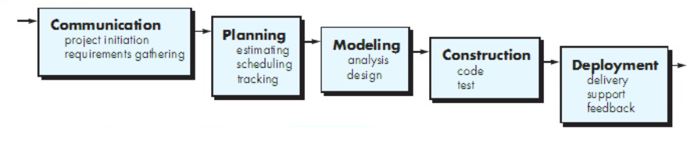

Slide 7
A variation of the representation of the waterfall model is called a V-model
It depicts the relationship of quality assurance actions to the actions associated with communication, modelling and construction activities.
A software team moves down the left side of the V where basic requirements are refined into progressively more detailed technical representation of the problem and its solution. Once the code had been generated, the team moves up the right side of the V, essentially performing a series of tests (quality assurance actions) that validate each of the models created as the team moves down on the left side of the V.
This provides a way of visualizing how verification and validation actions are applied to the earlier engineering work

Slide 8
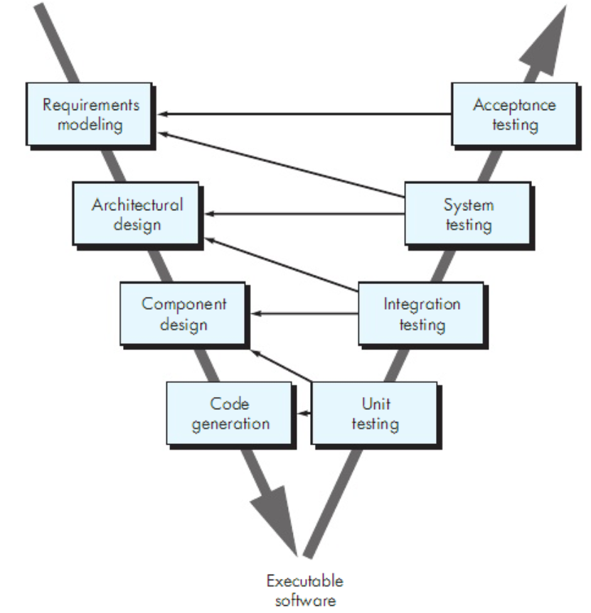

Slide 9
Problems encountered
Real projects rarely follow the sequential flow that the model proposes thus can cause confusion as the project team proceeds
It is often difficult for the customer to state all requirements explicitly
The customer must have patience
Leads to blocking state. Some project team members must wait for the other team members to complete dependent task

Slide 10
Incremental process models
This combines linear and parallel process flows. It applies linear sequences in a staggering fashion as calendar time progresses. Each linear sequences produces deliverable increments in the software
When this model is used, the first increment is often a core product, that is, basic requirements are addressed but many supplementary features, some known or unknown, remain undelivered.
The core product is used by the customer or undergoes detailed evaluation and as a result of use and or evaluation, a plan is developed for the next increment.
The plan addresses the modification of the core product to better the needs of the customer and the delivery of additional features and functionality.
This process is repeated following the delivery of each increment until the complete product is produced

Slide 11
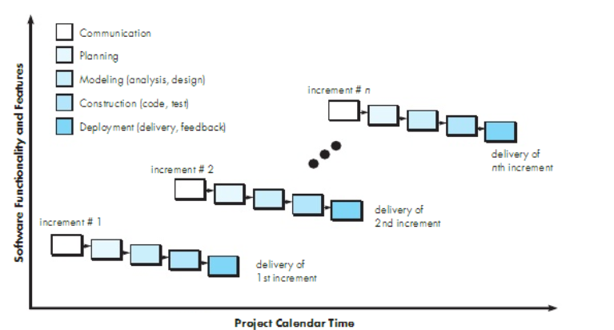

Slide 12
Evolutionary process models
Software evolves over a period of time and business and product requirements often change as development proceeds. In this situation, evolutionary process models are needed that has been explicitly designed to accommodate a product that grows and changes
These models are iterative, characterized in a manner that enables someone to develop increasingly more complete versions of the software

Slide 13
Two common evolutionary process models
Prototyping
The spiral model

Slide 14
Prototyping
When a customer has a legitimate need but is clueless about the details, develop a prototype as a first step, prototyping paradigm
Can be used as a stand alone process model
This assists in understanding better what is to be built when the requirements are fuzzy
This begins with communication where the stakeholders define the overall objectives of the software, identify what requirements are known and outline areas where further definition is mandatory
A prototyping iteration is planned quickly and modelling in form of quick design occurs which focuses on the representation of the software that will be visible to the end user
This leads to the construction of a prototype

Slide 15
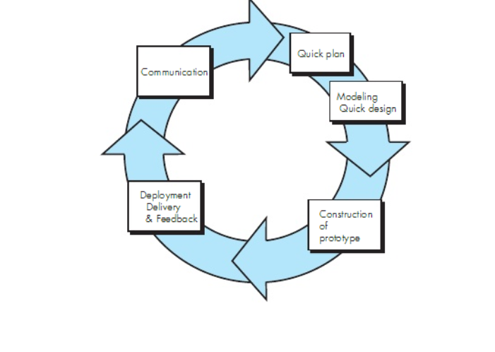

Slide 16
The spiral model
It is an evolutionary process software that couples the iterative nature of prototyping with the controlled and systematic aspects of the waterfall model
It has 2 main distinctive features;
cyclic approach for incrementally growing a systems degree of definition and implementation while decreasing its degree of risk
set of anchor point milestones for ensuring stakeholders commitment to feasible and mutually satisfactory system solutions
it is divided into a set of framework activities defined by the software engineering team where each framework activity represents a segment of the spiral path

Slide 17
the first circuit around the spiral might result in development of the product specification, subsequent passes around the spiral might be used to develop a prototype and then progressively more sophisticated versions of the software
each pass through the planning region results in the adjustments of the project plan
cost and schedule are adjusted based on the feedback derived from the customer after delivery
the project manager adjusts the planned number of iterations required to complete the software
this model can adapt to apply throughout the life of a computer software, the first circuit around the spiral might represent a concept development project that starts at the core of the spiral and continues for multiple iterations until concept development is complete

Slide 18
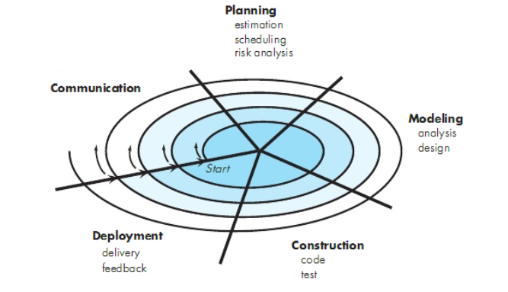

Slide 19
concurrent models
It sometimes called concurrent engineering
allows software team to represent iterative and concurrent elements of any of the process models
this model defines a series of events that will trigger transitions from state to state for each of the software engineering activities, actions or tasks
an inconsistency in the requirements is uncovered. This generates the event analysis model correction which will trigger the requirements analysis action from the done state into the awaiting changes state
this provides an accurate picture of the current state of a project

Slide 20
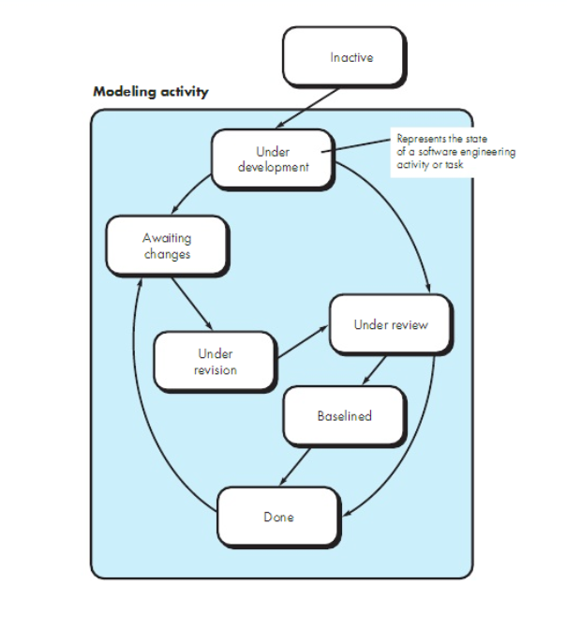

Slide 21
specialized process models
They are applied when a specialized or a narrowly defined software engineering approach is chosen

Slide 22
Types of specialized process models
component based development
the formal methods model
aspect oriented software development

Slide 23
component based development
commercial off the shelf (COTS) software components developed by vendors who offer them as products, provide targeted functionality with well-defined interfaces that enable the component to be integrated into the software that is to be built.
However, the component based development model comprises applications from the prepackaged software components

Slide 24
Steps for incorporating component based development
available component based products are researched and evaluated for the application domain in question
component integrated issues are considered
a software architecture is designed to accommodate the components
components are integrated into the architecture
comprehensive testing is conducted to ensure proper functionality

Slide 25
the formal methods model
this encompasses a set of activities that leads to formal mathematical specification of computer software
formal methods enable you to specify, develop and verify a computer based system by applying a rigorous mathematical notation
a variation on this approach is called clean room software engineering
when formal methods are used during development, they provide a mechanism for eliminating many of the problems that are difficult to overcome using other software engineering paradigms like ambiguity, incompleteness and inconsistency through application of mathematical analysis

Slide 26
aspect oriented software development
regardless of the software process that is chosen, the builders of complex software invariably implement a set of localized features, functions and information content
the localized software characteristics are modelled as components and then structures within the context of a system architecture
some concerns are high level properties of a system eg security other concerns affect functions eg application of business rules while others are systemic eg memory management
when concerns cut across multiple system functions, features and information are referred to as crosscutting concerns

Slide 27
aspect requirements define those crosscutting concerns that have an impact across the software architecture
aspect oriented software development is a software engineering paradigm that provides a process and methodological approach for defining, specifying, designing and constructing aspects

Slide 28
unified process
software development framework used for object-oriented modeling. The framework is also known as Rational Unified Process (RUP) and the Open Unified Process (Open UP)
Some of the key features of this process include:
It defines the order of phases.
It is component-based, meaning a software system is built as a set of software components. There must be well-defined interfaces between the components for smooth communication.
It follows an iterative, incremental, architecture-centric, and use-case driven approach

Slide 29
phases of unified process
Inception phase
Elaboration phase
Construction phase
Transition phase
Production phase

Slide 30
Inception phase
This encompasses customer communication and planning activities
Business requirements for the software are defined, a rough architecture for the system is proposed and a plan for the iterative and incremental nature of the ensuing project is developed
Elaboration phase
This encompasses communication and modelling activities of the generic process models
It expands the architectural representation to include the use case model, the analysis model, the design model, the implementation model and the deployment model

Slide 31
Construction phase
Using architectural model as the input, this phase develops or acquires the software components that will make each use case operational for end users
Transition phase
The software is given to the end users for beta testing and user feedbacks reports both defects and necessary changes
The software team creates necessary support information eg user manuals that is required for the release
Production phase
The ongoing use of software is monitored
Support for the operating environment is provided
Defect reports and requests for changes are submitted and evaluated

Slide 32
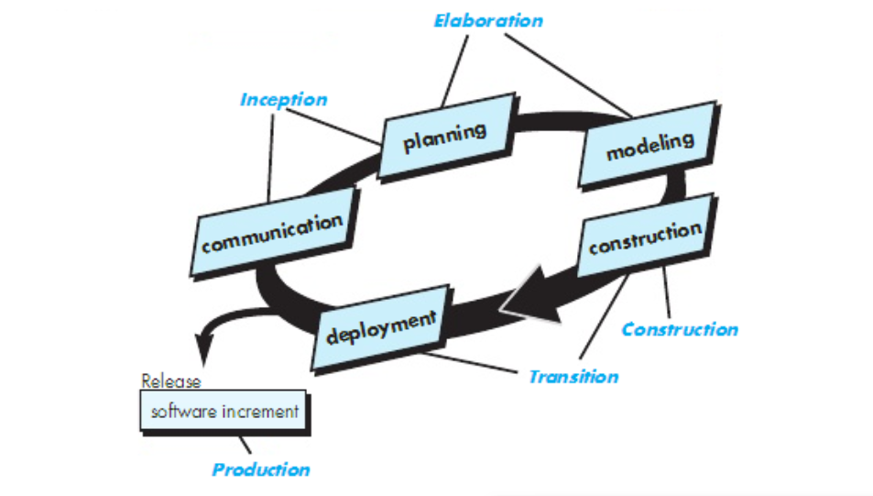

Slide 33
Personal and team process models
Personal software process (PSP)
team software process

Slide 34
Personal software process (PSP)
This emphasizes personal measurement of both the work product that is produced and the resultant quality of the work product
Five framework activities
planning. This activity isolates requirements and develops both size and resource estimates. Development tasks are identified and project schedule is created

Slide 35
high level design. External specifications for each component to be constructed are developed and a component design is created as well as the prototypes
high level design review. Formal verifications applied to uncover errors in the design
development. Component level design is refined and reviewed. Code is generated, reviewed, compiled and tested
postmortem. Using the measures and the metrics collected, the effectiveness of the process is determined

Slide 36
team software process
goal is to build a self-directed project team that organizes itself to produce high quality software
objectives
build self-directed team that plan and track their work, establish goals and own their processes and plans
show managers how to coach and manage their teams and how to help them sustain peak performance

Slide 37
accelerate software processes improvement
provide improvement guidance to high maturity organizations
facilitate university teaching of industrial grade team skills
defines the following framework; project launch, high level design, implementation, integration and test, postmortem

Slide 38
process technology
process technology tools are tools that have been developed to help software organizations analyze their current process, organize work tasks, control and monitor progress and manage technical quality. They allow software organizations to build an automated model of the process framework, tasks sets and umbrella activities thus reducing development time and cost

